Slide 1

Super Smash Brothers Ultimate
10/3/2021-001-016

Slide 2
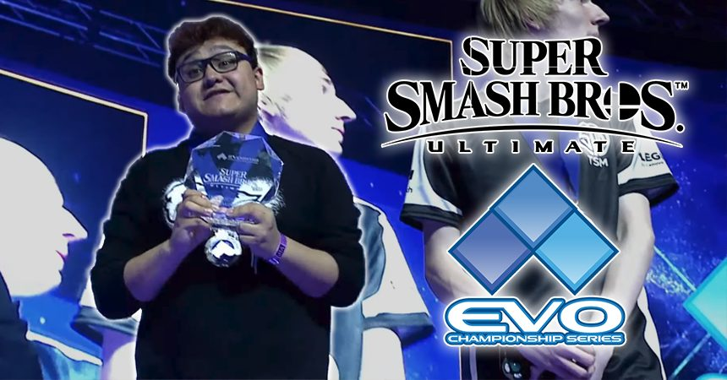
Having a regular training schedule
Will increase your Win rate in super smash brothers ultimate
Because having a regular training schedule will increase your spatial reasoning, reaction, and technique in the game

Slide 3
Importance of scheduling
Motivation
Regular Training
Plan and Goals
Time Management

Slide 4
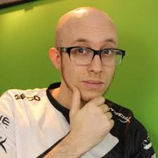
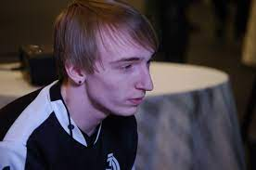

Why this matters
It is a rather big controversy on the best way to practice and improve

